Slide 1
Socket and Process Communication
application layer
application layer
User Process
Internet
User Process
Socket
Socket
OS network
stack
OS network
stack
transport layer (TCP/UDP)
transport layer (TCP/UDP)
Internet
network layer (IP)
network layer (IP)
link layer (e.g. ethernet)
Internet
link layer (e.g. ethernet)
The interface that the OS provides to its networking subsystem
Notes:
So how can applications running on your laptop or phone access all this to talk to each other?
>>> answer is with SOCKETS, interface the OS provides

Slide 2
Socket and Process Communication
Receiving host
Destination address that uniquely identifies host
IP address: 32-bit quantity (“1.2.3.4”)
Receiving socket
Host may be running many different processes
Destination port that uniquely identifies socket
Port number: 16-bits (“80”)
Process
A
Process
B
port X
Port
Number
port Y
TCP/UDP
Protocol
IP
Host
Address
Ethernet Adapter
Notes:
Now let's talk about naming: how do sockets get NAMED so that a host on the Internet can talk to another?

Slide 3
Socket and Process Communication
Two types of Sockets:
Stream Sockets: ‘Reliable’ TCP connections
Guarantees that the message sent will be delivered in the same order as they are sent.
A connection is established between the two ends before message is sent
Datagram Sockets: UDP Connections
No guarantee on message delivery – maybe lost, may get reordered.
Connectionless – The message is simply sent.
Notes:
Now let's talk about naming: how do sockets get NAMED so that a host on the Internet can talk to another?

Slide 4
Socket Programming
The idea of socket programming is to use the socket interface for communicating between processes/applications running across the network.
You may want to download a file stored on a server.
You may want to create an application which to chat with your friends.
Let us look at socket programming briefly using C. The key ideas will remain same across different languages, only the syntax will differ.

Slide 5
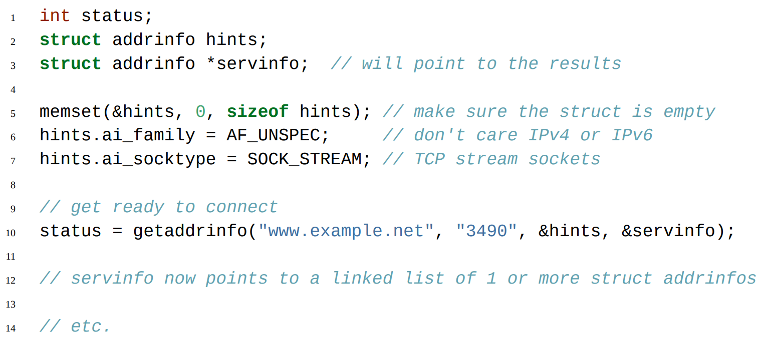
Get the Address of the service/device you are trying to access/want to use : getaddrinfo

Slide 6
Problem: Create a program that receives messages over the network and act accordingly / create a SERVER
Lets think on what all we need to do :
Goal: To create a socket that can be used to listen to incoming connections.
Create a TCP socket.
Associate the socket with a PORT number.
Listen to incoming connections.
Accept incoming connections
Send a message to client/receive a message from client

Slide 8
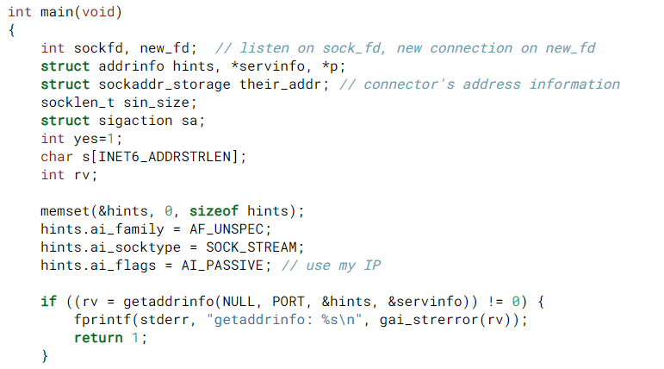
Use getaddrinfo to collect information about our own IP.

Slide 10
Problem: Create a program that connects to another process / create a CLIENT
Lets think on what all we need to do :
Goal: To create a socket that can be used to listen to incoming messages
Create a TCP socket.
Associate the socket with a PORT number.
Connect to remote process.
Send a message to server/receive a message from server.

Slide 11
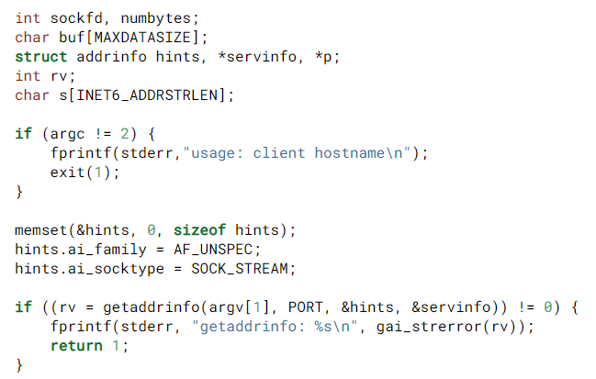
Use getaddrinfo to collect information about server IP.

Slide 12
Bind is not needed as we don’t intend to act as a listener for incoming connections and hence associating a fix port number is not necessary

Slide 13
Blocking calls vs Polling
accept and recv are both blocking calls, it means that at these calls the program halts and the control is transferred back to the OS. The OS returns to them when a new connection is available or new data is received.
Notes:
Polling based designs are not needed for assignment 1

Slide 14
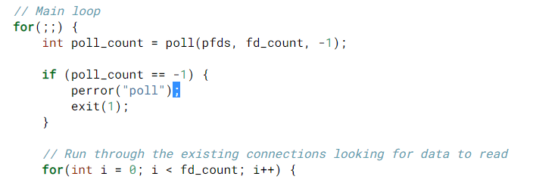
Process 1
Solution?
Non-Blocking calls/polling based design
Socket1
Socket2
Socket3
Can receive on only one socket at a time
Idea: OS will collect the relevant events (e.g. received messages) in a queue and it is the programs responsibility to repeatedly check the queues and address the events.
Look at ‘Slightly Advanced Techniques’ in the Beej’s guide

Slide 15
How can sockets be used to communicate between two processes on the same machine?

